Slide 1

A1: Conceptual Architecture of Void
welcome to one homepage
Group 10 “welcome to my homepage”
https://youtu.be/xN0TvQjVk_Y
Notes:
Hello everyone, we’re Group 10 — “Welcome to my homepage” — and today I’ll be walking you through our report on the Conceptual Architecture of Void, an AI-native, privacy-first code editor built as an open-source fork of Visual Studio Code.

Slide 2

Team welcome To my homepage
welcome to two homepage
Leader:
Ori Dembo 20387149 - System Functionality, Intro, Formatting, Slideshow
Presenters:
Alec Nakhnikian 20407121 - Slideshow, System Evolution, Citations, AI Collaboration
Tomer Lapid 20422876 - Slideshow, Concurrency, Lessons Learned, Conclusion
Other Members:
Linus Li 20349558 - Control & Dataflow, Formatting
Logan Bramwell 20386931 - UML Diagrams, AI Collaboration, Formatting
Mathieu Chretien - Conceptual Architecture, Division of Responsibility, Formatting

Slide 3

Abstract
welcome to three homepage
Void is a privacy-first, open-source fork of Visual Studio Code
Adds AI-native features (quick inline edits, contextual chat, autocomplete, and agentic tools) without sending code through proprietary servers
Built on VS Code’s Electron foundation with new AI runtime and Apply/Checkpoint pipeline.
Architecture enables responsiveness, testability, and evolvability through clear boundaries between subsystems.
Notes:
Void is a privacy-first, open-source fork of Visual Studio Code, and is designed to deliver “Cursor-class” AI assistance — all without sending developer code through a proprietary relay.
It’s built on top of VS Code’s Electron foundation and adds a new AI runtime with an Apply and Checkpoint pipeline.
The overall architecture emphasizes responsiveness, testability, and evolvability through clean boundaries between its subsystems.

Slide 4

Subsystem 1 - Renderer/UI
welcome to five homepage
User-facing subsystem
Renders editor, chat, settings, diff, and checkpoints
Streams AI output back to UI live
Orchestrates user input into AI runtime
Built with React for responsiveness
Performance, testability, and evolvability through isolation
Notes:
The Workbench, or Renderer process, is the user-facing core.
It displays the editor, chat, settings, and diff review panels.
Built with React, it streams AI output live while maintaining responsiveness.
By isolating the UI from computation, the Workbench achieves strong performance and testability, making it easy to evolve without affecting deeper layers.

Slide 5

Subsystem 2 - AI Agent Layer
welcome to six homepage
Middle layer between Renderer and Model/Provider
Exposes user-available AI features: Chat, Quick/Inline Edit, Agent, Gather
Transforms prompts into structured edit intents and tool requests
Applies capability gating (FIM, tool use, reasoning levels)
Enforces user approval for agentic actions
Orchestrates multi-step, file-aware workflows with the AI
Notes:
The AI Agent Layer sits between the UI and the model providers.
It exposes user-visible AI capabilities — Chat, Quick Edit, Agent, and Gather modes.
This layer translates natural-language prompts into structured edit intents and applies capability gating to ensure each model only performs the actions it supports.
It also enforces explicit user approval for any agentic operation, keeping the developer firmly in control.

Slide 6

Subsystem 3 - Model/Provider Layer
welcome to seven homepage
Resides in Main Process (Node.js environment)
Adapts cloud APIs and local LLMs
Handles capacity detection
Streams tokens
Manages timeouts, retires, and rate limits
Provides facade/interface layer for Agent layer
Ensures privacy-first routing
Notes:
The Model Provider Layer lives in the Main Process.
It connects directly to APIs like OpenAI, Anthropic, or local runtimes such as Ollama.
This subsystem handles capability detection — for example, whether a model supports fill-in-the-middle completion, tool-calling, or reasoning modes.
It also manages rate limits, retries, and streaming tokens back to the Agent Layer.
In short, it’s the bridge that enables Void’s “any LLM, anywhere” promise while preserving privacy.

Slide 7

Subsystem 4 - Apply/Checkpoint Pipeline
welcome to eight homepage
Converts model outputs to structured edit blocks to visual diffs
Approved changes are applied atomically to ensure safety and auditability
Records checkpoints - allows for rollbacks and version history
Enforces the idea of human-in-the-loop control for no automatic file writes
Pipeline style: parse -> diff -> approve -> apply -> checkpoint
Guarantees deterministic and reversible edits
Notes:
The Apply and Checkpoint Pipeline converts model outputs into structured edit blocks and visual diffs.
Once the user approves an edit, it’s applied atomically, recorded as a checkpoint, and can be rolled back at any time.
This pipeline enforces the human-in-the-loop principle — nothing in Void is ever written automatically — ensuring every change is deterministic, auditable, and reversible.

Slide 8
Subsystem 5 - Platforms and Integrations
welcome to nine homepage
Covers Extension host, LSP, terminal, and auto-update systems
Handles packaging, updates, and cross-platform builds (macOS, Windows, Linux)
Fault isolation and stable process separation
Enables language intelligence through LSP servers - communicates via JSON-RPC
Supports background tools (terminal, SSH/WSL) for agentic workflows
Maintains compatibility with VS-Code ecosystem - themes, extensions, key bindings
Notes:
The final subsystem covers Platform and Integrations.
This includes the Extension Host, Language Server Protocol servers, terminals, packaging, and auto-updates.
These components provide language intelligence and system-level features while keeping processes isolated for stability.
Together they maintain full VS Code compatibility — from themes and extensions to cross-platform builds — while extending its capabilities for AI workflows.

Slide 9

Subsystem Interactions
welcome to ten homepage
Renderer/UI captures user prompts and edit context
Sends request via IPC to AI Agent Layer
Agent Layer formats structured edit intents and forwards to Model/Provider Layer
Provider Layer streams model outputs (tokens, diffs) back to Agent & Renderer
Apply/Checkpoint Pipeline converts results → diffs → approved edits
Platform/Integrations support LSP, terminals, and extensions independently
Loop closes as accepted edits update workspace and context
Notes:
All five subsystems interact through asynchronous boundaries.
The Workbench captures a user prompt and sends it via IPC to the Agent Layer, which creates a structured request for the Model Provider Layer.
The provider streams results back through the Agent to the UI, where the Apply Pipeline displays diffs and waits for approval.
Once accepted, edits update the workspace, closing the loop.
This IPC-driven design keeps the system responsive and fault-tolerant.

Slide 10
Architectural Styles
welcome to illeven homepage
Layered Architecture:
Renderer → Agent → Provider → Apply → Platform
Supports modularity and clear responsibility boundaries
Microkernel / Plug-in Style:
Extension Host & LSP act as isolated plug-ins for language features
Implicit Invocation:
Asynchronous streams, IPC, and JSON-RPC enable decoupled communication
Client–Server:
Renderer (client) ↔ Main Process / Providers (servers) interactions
Hybrid Composition:
Combines styles to balance extensibility, responsiveness, and evolvability
Notes:
Void blends several classic architectural styles.
It’s primarily Layered, moving from the Workbench down to Platform integrations.
It also follows a Microkernel or plug-in style through the Extension Host and LSP.
Communication uses Implicit Invocation via IPC and JSON-RPC streams, while the Renderer and Main Process follow a Client-Server model.
This hybrid composition gives Void both structure and flexibility.

Slide 11

Major Version Highlights
welcome to twelve homepage
V1.0.0 - Quick-edits, autocomplete, native migration to VS-Code codebase, updated UI, file suggestions, Apache 2.0 license change
V1.0.2 - Agent, Chat, and Gather modes added, auto-detected model support, reasoning slider, Fast Apply, increased model selection
V1.2.1 - Checkpoints, updated tool-calling, SSH/WSL support, auto-updates, further model support
V1.3.9 - Increased configuration, terminal tools, Linux support, Faster Fast-Apply, @file and @folder ability, reasoning effort sliders, new onboarding sliders
V1.4.1 - MCP Support, AI-commit messages, increased model support
Notes:
Over time, Void has evolved rapidly through several major versions.
Version 1.0 introduced Quick Edits, Autocomplete, and a move from an extension to a full editor.
Version 1.0.2 added Agent, Chat, and Gather modes plus capability detection and model detection with increased model selection.
Version 1.2.1 brought Checkpoints, auto-updates, SSH/WSL support, and further model support.
Version 1.3.9 expanded configuration options and added Linux support.
Version 1.4.1, the most recent version, introduced the MCP Support, AI commit messages, visual diffs, and further model support.
These milestones trace Void’s growth from a simple inline editor to a full agentic, AI-driven development environment.

Slide 12
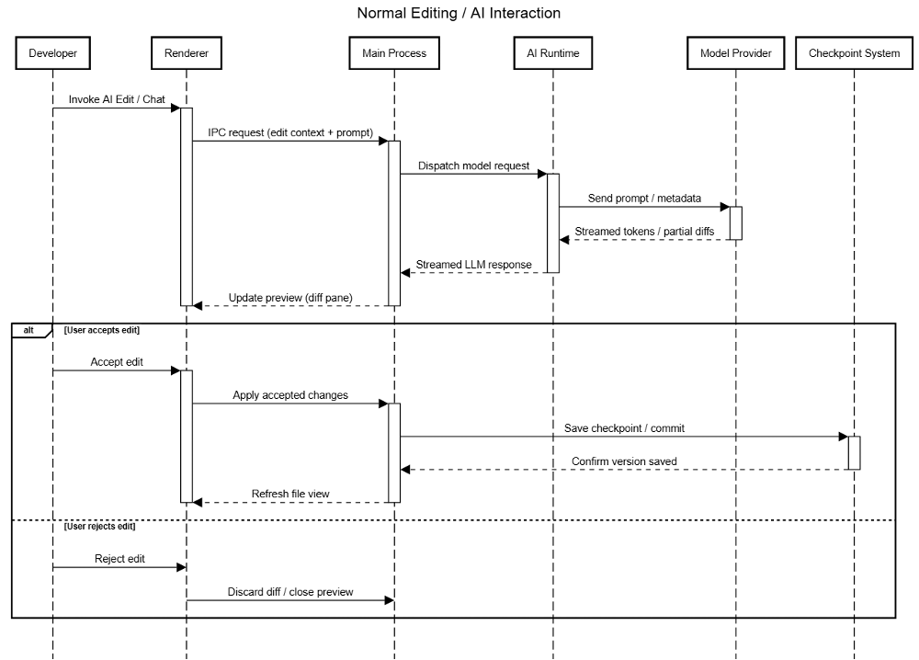
Use Case #1 - AI Editing Interaction
welcome to thirteen homepage
Notes:
Here, we showcase a use case for the Void Editor - a basic editing with AI interaction. Firstly, the developer invokes the AI to edit or chat, which goes through the UI Renderer down through the layers to the model provider, which then sends a response back to the Renderer to preview the update.
From here, the user can either accept the edits, which then get saved as a checkpoint in the checkpoint system, and the renderer is refreshed.
If they instead reject the edit, then the diff is discarded and the edit preview is closed

Slide 13

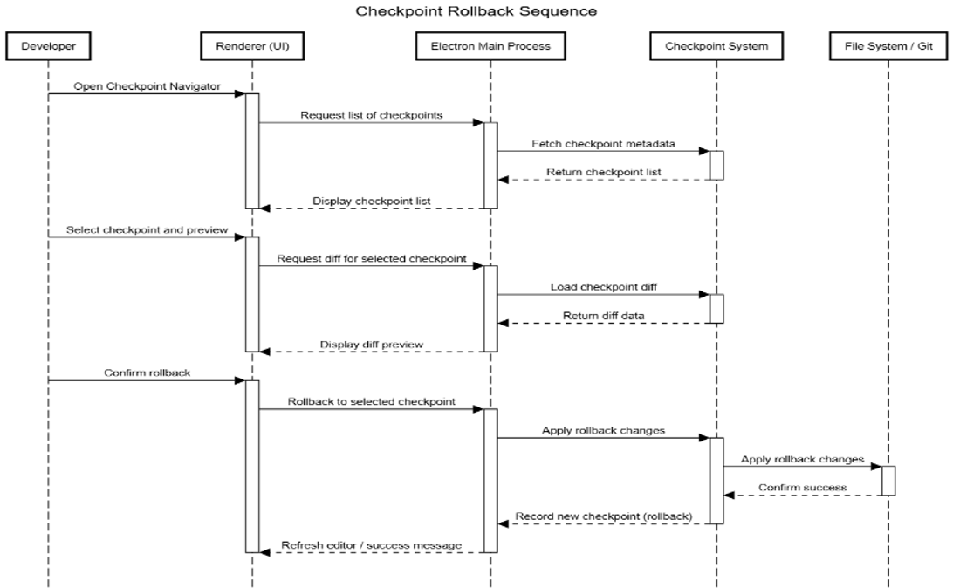
Use Case #2 - Checkpoint Rollback
welcome to forteens homepage
Notes:
The second use case we will go over is the checkpoint rollback sequence.
Here’s how that rollback process works:
The user opens the Checkpoint Navigator, which will go through the layers down to the checkpoint system and returns a list to the renderer.
From there the user can select a checkpoint to preview, this trickles down into the checkpoint system which loads a display of the preview onto the renderer.
From there the user is able to confirm a rollback. This call travels down all the way to the file system which applies the rollback changes. And then the new checkpoint is confirmed and the editor gets refreshed with those new changes.

Slide 14

Concurrency
welcome to fifteen homepage
Inherits multi-process concurrency from Electron
Main Process, Renderer, Extension Host, and LSPs
LSPs run as separate processes through JSON-RPC
Parallel execution of AI calls, extensions, and diagnostics
Renderer stays responsive through heavy workloads handled through background processes
AI tasks routed through Main Process to bypass browser limits and maintain security
Notes:
Void inherits its multi-process concurrency design from Electron, so the Main Process, Renderer, Extension Host, and Language Servers all run in parallel.
Each LSP runs in its own process via JSON-RPC, letting multiple languages work simultaneously without slowing the editor.
This setup enables parallel AI calls, extensions, and diagnostics while the UI stays smooth.
Heavy tasks, like model requests or file operations, run in background processes, with AI routed through the Main Process for speed and security.

Slide 15

Control and Data Flow
welcome to sikisteen homepage
Built on Electron’s multi-process model
Main Process connected to Renderer through IPC
Main Process handles system logic
Service Oriented: each feature (AI service, editCodeService, tools) run independently
Singleton Settings Service shares consistent configuration across processes
React UI updates efficiently through the Virtual DOM
Asynchronous IPC ensures non-blocking communication and smooth streaming
Notes:
Void follows Electron’s multi-process design.
The Main Process handles file access, plugins, and model inference, while the Renderer runs the UI.
They communicate through async IPC, so even during AI streaming, the interface stays smooth.
Inside, Void uses independent services for AI, editing, and tools, all synced by a Singleton Settings Service.
The React UI updates only what changes, keeping everything fast and responsive, even under heavy workloads.

Slide 16

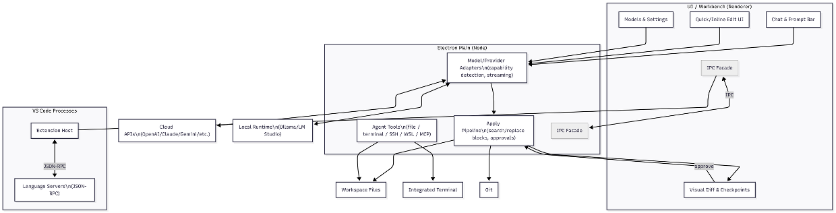
Conceptual Architecture
welcome to seventeen homepage
Notes:
Here we have a diagram of the the conceptual architecture for Void.
First we have: The VS Code Base 0(on the left)
On the left is the original VS Code code base, the Extension Host and Language Servers, which communicate through JSON-RPC.
That’s how existing features like autocomplete and syntax highlighting already work.
AI Integrations (center-left)
Void connects to both cloud models like OpenAI, Claude, and Gemini, and local ones like Ollama, giving users the choice between the two.
Electron Main Process (center)
This is Void’s AI core, running safely outside the browser sandbox.
Inside are three key modules:
• Model/Provider Adapters – manage and detect each AI model’s capabilities.
• Agent Tools – access files, terminals, or systems like SSH and MCP.
• Apply Pipeline – turns AI suggestions into code changes.
Renderer / Workbench (right)
On the right is the UI, chat, inline edits, and settings, all talking to the Main Process through a typed IPC layer.
Data & File Interactions (bottom)
Finally, the Apply Pipeline links to Checkpoints, Git, and workspace files, keeping every edit traceable and reversible.

Slide 17
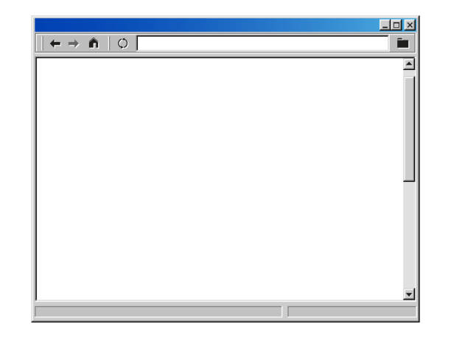
Division of Responsibilities
welcome to eighteen homepage
Platform & Upstream Sync (Electron + VS Code)
Maintain main/renderer wiring, typed IPC, packaging & auto-updates
Coordinate rebases with upstream VS Code and Electron releases
AI Runtime & Provider Integrations (Main Process)
Provider adapters (cloud/local), streaming, rate limits, and capability detection
Ensure that no data goes through third-party servers, instead using direct model connections (privacy-first design)
Notes:
Void’s architecture naturally divides work along its process boundaries.
The Platform and Upstream Sync team maintains Electron, IPC wiring, and rebases from VS Code, keeping the core stable and secure.
The AI Runtime and Provider Integrations team manages adapters for cloud and local models, handles streaming, rate limits, and ensures all data stays private with no third-party relays.
Division of Responsibilities
1. Platform & Upstream Sync (Electron + VS Code)
This team maintains the editor’s foundation — how the renderer (UI) communicates with the main system.
They handle packaging, updates, and lifecycle, and keep Void synced with new Electron and VS Code versions.
If upstream updates break anything, this team fixes it to keep Void stable.
2. AI Runtime & Provider Integrations (Main Process)
This team manages how Void connects to AI models like Claude, GPT, Gemini, and local ones like Ollama.
They handle streaming, rate limits, and feature detection — all while ensuring privacy through direct, serverless connections.
They’re what keeps Void’s AI both flexible and private, isolating the UI from backend complexity.

Slide 18
Division of Responsibilities
welcome to nineteen homepage
Workbench & UX (Renderer)
Chat/Quick Edit UI, visual diffs, Checkpoints navigator, onboarding/settings
UI consumes services via IPC only (no Node/SDKs in renderer)
Apply/Checkpoint Pipeline (Main)
Transforms model output → diff blocks → user approval → atomic write
Record Checkpoints for rollback and audit
Language Platform & Extensions (Ext Host + LSP)
Maintain LSP client/server lifecycle, ensure extension fault isolation
Support multiple concurrent language servers via JSON-RPC
Notes:
The Workbench and UX team owns everything user-facing — chat, quick edits, diff views, checkpoints, and onboarding.
They focus on accessibility and smooth performance across platforms.
The Apply and Checkpoint Pipeline team handles the backend logic that transforms model output into reviewable diffs and checkpoints, guaranteeing human approval before any file is changed.
3. Workbench & UX (Renderer)
Builds the chat, inline edits, and settings UI.
Shows AI output live but never touches files or the web. Everything goes through safe IPC.
Keeps the interface fast and secure.
4. Apply / Checkpoint Pipeline (Main Process)
Applies AI edits only after approval and saves each as a checkpoint for undo or review.
Guarantees human-in-the-loop safety.
5. Language Platform & Extensions (LSP)
Runs syntax, linting, and autocomplete in separate processes.
Prevents crashes and lets AI tools run smoothly beside normal coding features.

Slide 19
Division of Responsibilities
welcome to twenty homepage
Privacy & Security (Cross-cutting)
Enforce explicit user approval for agent tools (FS, terminal, SSH, MCP)
Harden IPC surfaces and guard local-only execution modes
Release Engineering & Developer Experience
Handle builds, installers, auto-updates, onboarding, and provider setup
Test local runtimes (Ollama) & cloud models for compatibility
QA & Performance
Load and scenario testing across OSes/providers
Monitor Fast-Apply throughput & renderer responsiveness
Notes:
The Language Platform and Extensions team keeps the LSP servers and Extension Host isolated so language tools run safely in parallel.
The Privacy and Security group reviews every new tool or integration, enforcing explicit user consent and guarding local-only execution.
Meanwhile, Release Engineering and Developer Experience builds installers, manages auto-updates, and ensures provider setup works across Windows, macOS, and Linux.
Finally, the QA and Performance team stress-tests the editor across OSes and providers, ensuring the renderer never lags even under heavy AI workloads.
6. Privacy & Security
Guards data boundaries and approves any feature that can access files or run code.
No data leaves the device without consent, keeping Void’s advertised “no-middleman” promise.
7. Release Engineering & Dev Experience
Builds installers, manages updates, and tests model setup on all platforms.
Ensures Void is easy to install, update, and contribute to.
8. Quality Assurance & Performance
Stress-tests AI calls and large files, checking speed and responsiveness.
Keeps Void feeling fast and reliable under heavy load.

Slide 20
Division of Responsibilities
welcome to twenty-oneth homepage
Collaboration Rules
Typed IPC is law:
Only the Platform team defines how the UI and main process talk.
Provider changes are runtimes jobs:
If someone adds a new AI model, it’s handles by the AI Runtime, not the UI team.
Apply is the only thing that writes files:
Even if Chat or Agent suggests edits, they must go through Apply -> user approval -> write.
Security gates required:
Any tool that touches the file system, terminal, or network must have explicit user consent and audited logging.
Notes:
Collaboration across teams follows strict architectural rules: all communication happens through typed IPC interfaces, only the Apply Pipeline can modify files, and any new provider or tool must go through security and privacy review before release.
These clear boundaries preserve stability, maintain accountability, and allow each team to move quickly without breaking the system.
There are rules of collaboration that underlie these systems:
1. Typed IPC is the Single Source of Truth
All communication between UI and Main is done through typed IPC.
The Platform team defines them, Runtime implements, UI just uses.
Prevents chaos and keeps all teams in sync.
2. Only Apply Pipeline Can Edit Files
AI can suggest changes, but only the Apply/Checkpoint Pipeline writes to disk, and only after user approval.
Ensures safety and control.
3. Provider Changes Stay in Runtime
New AI models (Gemini, Claude, etc.) are integrated only in the Runtime layer.
The UI never breaks when new providers are added, keeping Void modular and evolvable.
4. Security Gates for New Tools
Any feature that can touch files or run code must go through a permission review and explicit user consent.
Guarantees privacy as nothing runs or sends data without your approval.

Slide 21

Lessons Learned
welcome to twenty-tooth homepage
Learned to navigate multi-layered architecture
Learnt to examine repos together
Learnt the importance of collaboration and coordination
Understood importance of reviewing AI-generated work
Learnt how to use AI for research and editing
Human oversight + AI tools improves productivity and accuracy
Notes:
One of our biggest takeaways was learning how to navigate multiple layers of documentation: Void, VS Code, and Electron, and figure out what belonged where.
It showed us how open-source projects extend existing systems rather than replace them.
We also learned the value of collaboration and consistency. Early on, we separated our tasks and worked individually so our sections looked different, so we had to align our style and work more closely as a team.
And while AI helped us research and organize faster, the project made it clear that human review is still essential for accuracy and cohesion.

Slide 22

AI Collaboration
welcome to twenty threeth homepage
OpenAI ChatGPT-5 (Sept & Oct 2025)
Chosen due to free usage of premium product & analytical depth
Collected sources, summarized docs, formatted drafts, refined grammar & style
All members collaborated on making context-rich prompts and personas
Validation through cross-checking with primary documentation
Contribution was about 20% - boosted speed and cohesion of work but required constant oversight and revision
Overall, AI amplified productivity but required active management and quality assurance
Notes:
For our AI teammate, we used ChatGPT-5 because it offered strong reasoning and premium tools without cost barriers.
We used it to gather and summarize sources, structure drafts, and polish grammar and style.
Our team wrote detailed, context-rich prompts to keep it aligned with our topic, and we verified every AI-generated section against the official documentation.
Overall, AI contributed about 20% of our work. It made us faster and more cohesive, but still needed active oversight to stay accurate and well-reasoned.

Slide 23

Conclusion
welcome to twenty fist homepage
Void extends VS Code with an AI-native, privacy-first architecture.
Built on Electron’s multi-process model, it separates the UI (Renderer), AI Runtime (Main), and Extensions (LSP) for responsiveness and safety.
Adds the AI Agent, Provider, and Apply/Checkpoint layers for secure, reviewable edits.
Blends Layered, Client-Server, and Implicit Invocation styles for flexibility and stability.
Human-in-the-loop control and strict collaboration rules ensure privacy and evolvability.
Notes:
Void builds on VS Code, but reimagines it as an AI-native, privacy-first editor.
It runs on Electron’s multi-process model, separating the UI, AI Runtime, and Extensions for speed and safety.
New layers like the AI Agent and Apply/Checkpoint system make every edit secure and reviewable.
By blending layered, client-server, and event-driven styles, Void stays flexible, stable, and built to be sustained for the future.

Slide 24
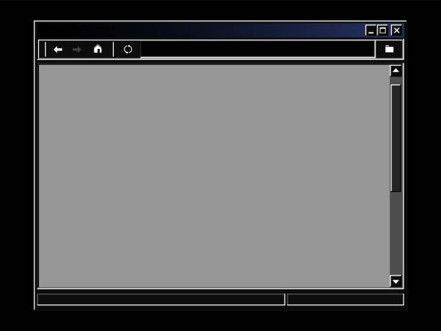
References
welcome to twenty fourst homepage
Void. Void Editor – Build with AI. Void Software, 2025, https://voideditor.com
Void. Void Editor – Build with AI. Void Software, 2025. https://www.voideditor.com.
“Changelog.” Void Editor, Void Software, 2025. https://www.voideditor.com/changelog.
“Void IDE Architecture Overview.” Zread, Accessed 9 Oct. 2025. https://www.zread.ai/voideditor/void/9-architecture-overview.
“Process Model.” Electron Documentation, Electron, Accessed 9 Oct. 2025. https://www.electronjs.org/docs/latest/tutorial/process-model.
“Inter-Process Communication.” Electron Documentation, Electron, Accessed 9 Oct. 2025. https://www.electronjs.org/docs/latest/tutorial/ipc.
“What Is SOA? Service-Oriented Architecture Explained.” Amazon Web Services, Amazon, Accessed 9 Oct. 2025. https://www.aws.amazon.com/what-is/service-oriented-architecture/.
“Singleton Method Design Pattern.” GeeksforGeeks, 26 Sept. 2025. https://www.geeksforgeeks.org/system-design/singleton-design-pattern/.
“React Component Based Architecture.” GeeksforGeeks, 23 July 2025. https://www.geeksforgeeks.org/reactjs/react-component-based-architecture.
“Extension Host.” Visual Studio Code Extension API Documentation, Microsoft, Accessed 9 Oct. 2025. https://www.code.visualstudio.com/api/advanced-topics/extension-host.
“Source Code Organization.” Visual Studio Code Wiki, GitHub, edited 2 Oct. 2025. https://www.github.com/microsoft/vscode/wiki/Source-Code-Organization.
“Language Server Protocol.” Microsoft Open Source, Microsoft, 2025. https://www.microsoft.github.io/language-server-protocol/.
“Chat Participants and Agents.” Visual Studio Code Extension Guide, Microsoft, Accessed 9 Oct. 2025. https://www.code.visualstudio.com/api/extension-guides/chat.
“VOID_CODEBASE_GUIDE.md.” Void Editor Repository, GitHub, Accessed 9 Oct. 2025. https://www.github.com/voideditor/void/blob/main/VOID_CODEBASE_GUIDE.md.
Couriol, Bruno. “The Void IDE, Open-Source Alternative to Cursor, Released in Beta.” InfoQ, 21 June 2025. https://www.infoq.com/news/2025/06/void-ide-beta-release/.
Rudra, Sourav. “Void Editor Is Shaping Up Well: Is It Ready to Take on Cursor and Copilot?” It’s FOSS News, 25 June 2025. https://www.news.itsfoss.com/void-editor/.
Kumar, Aditya. “Void IDE: The Comprehensive Guide to the Open-Source Cursor Alternative.” Medium, 24 Mar. 2025. https://www.medium.com/@adityakumar2001/void-ide-the-comprehensive-guide-to-the-open-source-cursor-alternative-2a6b17cae235.
Kumar, Ayush. “Void + Ollama + LLMs: How I Turned My Code Editor into a Full-Blown AI Workbench.” DEV Community, 26 May 2025. https://www.dev.to/nodeshiftcloud/void-ollama-llms-how-i-turned-my-code-editor-into-a-full-blown-ai-workbench-eop.

Slide 25
Thank you >3> !!!!11!!!1
welcome to twenty sips homepage

